Slide 1
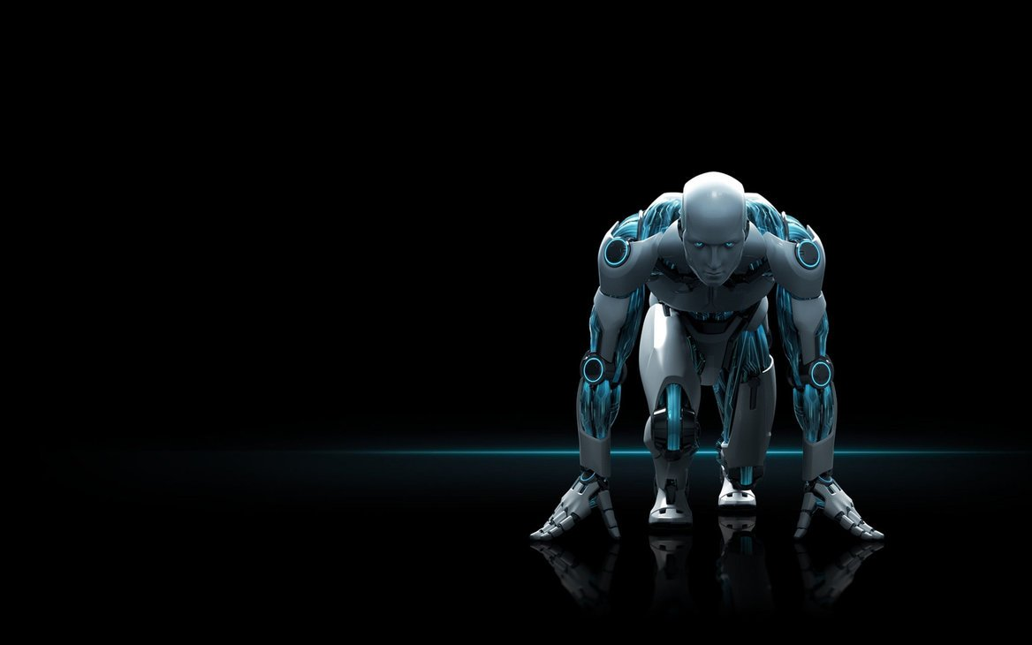
AI CURL TRACKER

Slide 2
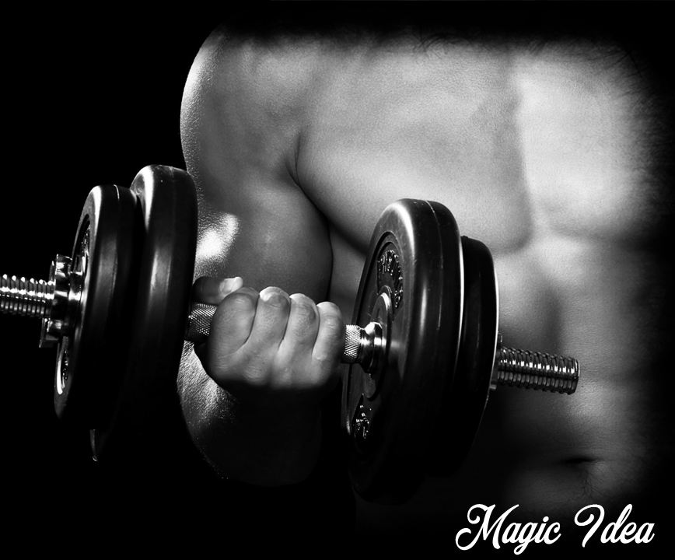
What is AI Curl Tracker ?
AI Curl Tracker is an AI based Fitness Tracker using MediaPipe , OpenCV and Python. It can detect various body postures like bicep curls, squats and so on. We have used the pose estimation to find the correct points and using these points we’ll get the desire angles. This tracker is going to track different fitness activities and render the results to the screen.

Slide 3
Overview :
AI Curl tracker is a software based on human pose estimation technique. The idea is to make the user aware of inaccurate range of motion in real time so that he/she can correct it immediately without the need of human exercising partner. Often as a novice we are dealing with incorrect exercising postures which eventually leads to no gain or in the worst conditions , unwanted damage and tear to the muscles.

Slide 4
The counter doesn’t tick if the range of motion during the bicep curl is within 40 degrees and 160 degrees. Hence to get the counter going, user has to curl and uncurl his/her biceps in a full range of motion. No cheating now!
Pose Landmark Model(BlazePose GHUM 3d) The landmark model in MediaPipe pose predicts the location of 33 pose landmarks(see figure below)

Slide 5
What is Pose Landmark Model:
The Pose Landmark API is a lightweight versatile solution for app developers to detect the pose of a subject's body in real time from a continuous video or static image.
A pose describes the body's position at one moment in time with a set of skeletal landmark points.

Slide 6
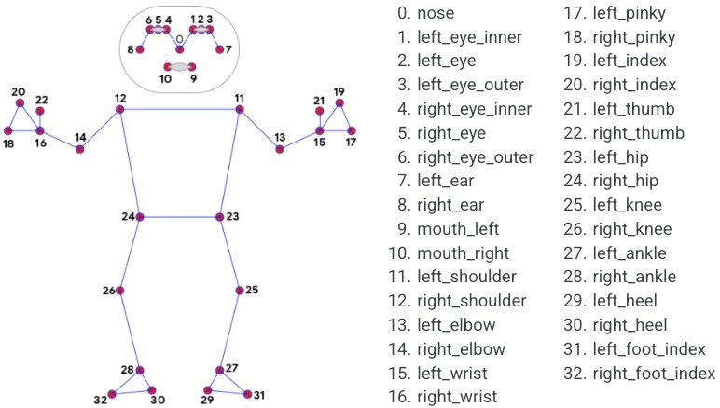
Fig : Pose Landmark Model

Slide 7
Steps Involved :
Install and Import Dependencies ( OpenCV , MediaPipe).
Make Detections.
Determining Joints.
Calculate angles.
Curl Counter.

Slide 8

What is MediaPipe ?
MediaPipe is a Framework for building machine learning pipelines for processing time-series data like video, audio, etc. This cross-platform Framework works in Desktop/Server, Android, iOS, and embedded devices like Raspberry Pi and Jetson Nano.

Slide 9
Hardware Requirement :
Processor : core i5 11th gen
Storage Required : 20 GB
RAM : 8 GB
Storage type : SSD

Slide 10
Software Requirement :
Operating System : Windows 10/11 (updated)
Programming Language : Python
Technology Used : Artificial Intelligence , Machine Learning

Slide 11
Working :
The Project is based on MediaPipe’s Pose Estimation Model Blazepose at the backend which is responsible for calculating the 3-D co-ordinates of the human body keypoints. We then extracts the three: wrist , elbow and shoulder keypoints and form two straight lines joining shoulder and elbow(A)/elbow and wrist(B). Calculating the angle between the two straight lines A and B gives us the angle formed at elbow of the hand which is then used for counter increments. A binary variable 'flag' is responsible for maintaining the position of the hand during curls; UP or DOWN. A successful transition of the hand from DOWN to UP increases the counter by 1 each time. Separate counters are maintained for right and left hands.

Slide 12
Advantages :
Easy to count the number of curls.
User has to curl and uncurl his/her biceps in a full range of motion. No cheating now!
Accuracy for counting the curls is good.
Separate count for left and right hands is maintained.
The model tracks the curl reps in real time.
User can focus on his/her exercise instead of counting steps.

Slide 13
Disadvantages :
A good quality camera is required.
This model can’t be used for more than one user at a time.
This model can be work in the presence of light.

Slide 14
Future Scope :
We can implement this project in gym to make them digitalize (People can easily start doing exercise just by tapping on device).
We can implement this in upcoming smart device with that user can do exercise by staying at their home.
Add Deadlift and many other exercises.

Slide 15
Conclusion :
At last the Conclusion of project is to build a model which is used to count the number of curls on the basis of Human Pose Estimation Model by using Mediapipe and OpenCV.

Slide 16
References :
https://en.wikipedia.org/wiki/Python_(programming_language)
https://mediapipe.dev
https://opencv.org
https://jupyter.org

Slide 17
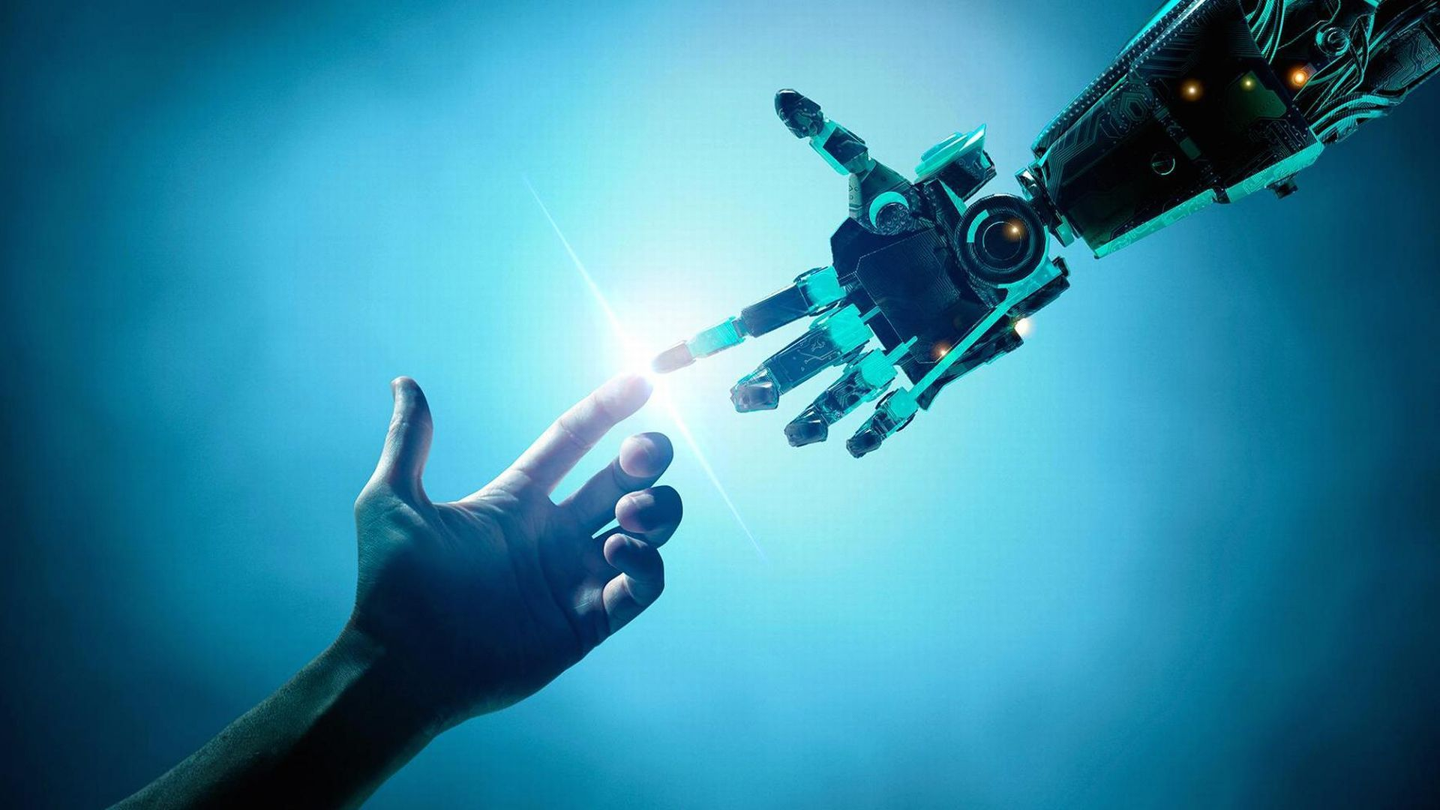
THANK
YOU

